Slide 1
SKILLS FOR DIALOGUE workshop 1 The importance of Shared, Brave & Safe Spaces

Slide 2
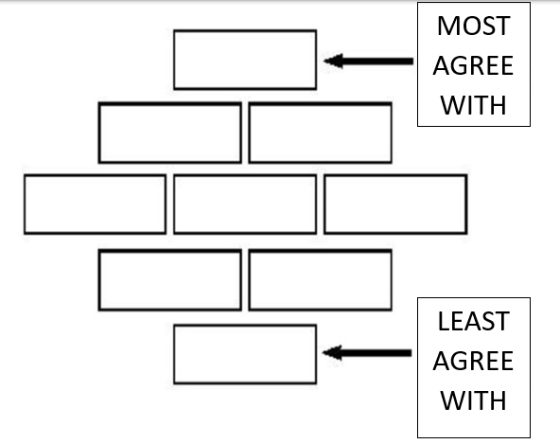
DIAMOND 9 - RANKING
WHAT DO WE MEAN BY DIALOGUE?
1. Read the 9 statements in your envelope and discuss
2. Now put them in order of the ones that you agree with the most to the least

Slide 3
Let’s have a think - Individual Task
On a separate post-it for each response, write answers to the following
What made you hesitate / not share something in the last activity?

Slide 4
Breaking the wall
What would make you feel comfortable to share answers that might be a little more personal or delve deeper?

Slide 5
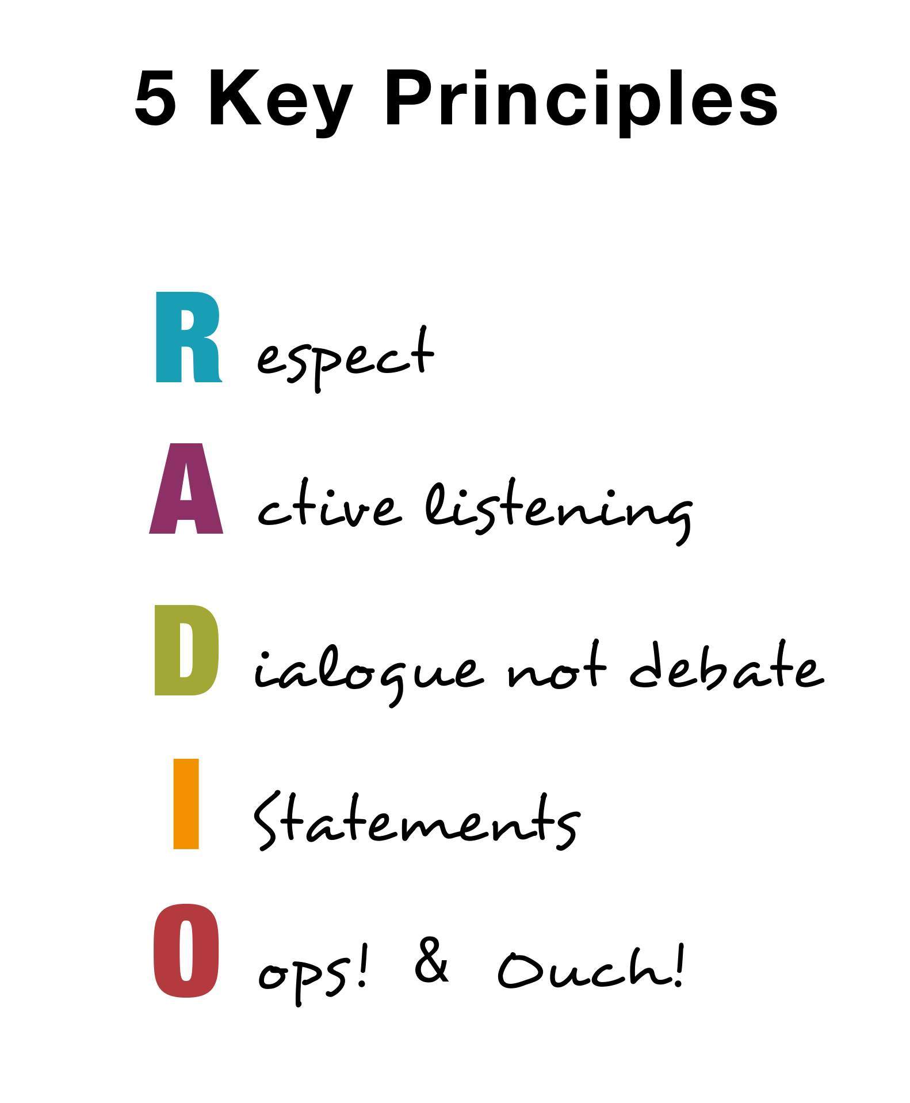
Use our video to help clarify dialogue principles!​
R
A
D
I
O

