Slide 1
SKILLS FOR DIALOGUE workshop 3 Power Roles & The Art of Asking

Slide 2
Two Truths & A Lie You will hear 3 statements - 2 are true - 1 is a lie -Can you guess which is the lie & why?

Slide 3
FEELING – THOUGHTS – ACTIONS, Deep Dive
Individually, on one side of the paper, write a few examples of when you were in a situation that you did not feel that you had power.
Think of 3 words to describe how you felt during or after these times and write these on the paper
Turn the paper over and write examples where you felt powerful.
Add the feelings that you felt during these examples.

Slide 4
Power Categories
Power can be categorised into 4 types
Power over: when one individual or group gets more power, the other gets less
Power to: Enables the individual to control or manage a situation to their benefit (empowerment)
Power with: a group tackles a problem together and creates a movement (collective power)
Power within: power that is within the individual based on self-acceptance and self-respect which leads to acceptance of others as equals (internal strength)

Slide 5
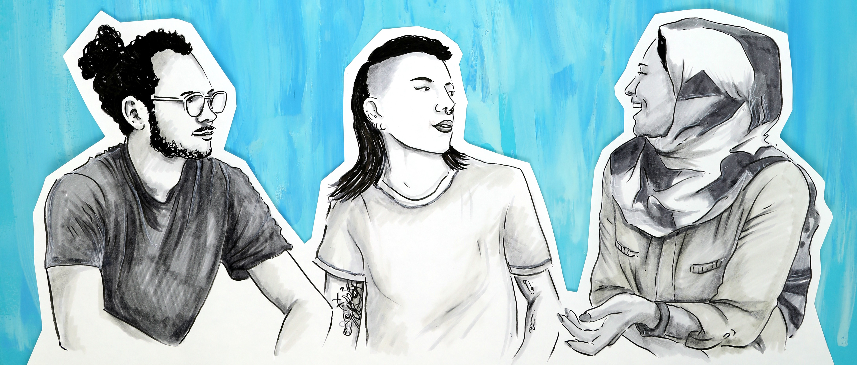
RSVP
R eally a question?
S tereotypes/generalisations
V iews
P rovocative language
?

