Slide 1
SKILLS FOR DIALOGUE workshop 4 The Art of REPLY

Slide 2
Ask me…

Slide 3
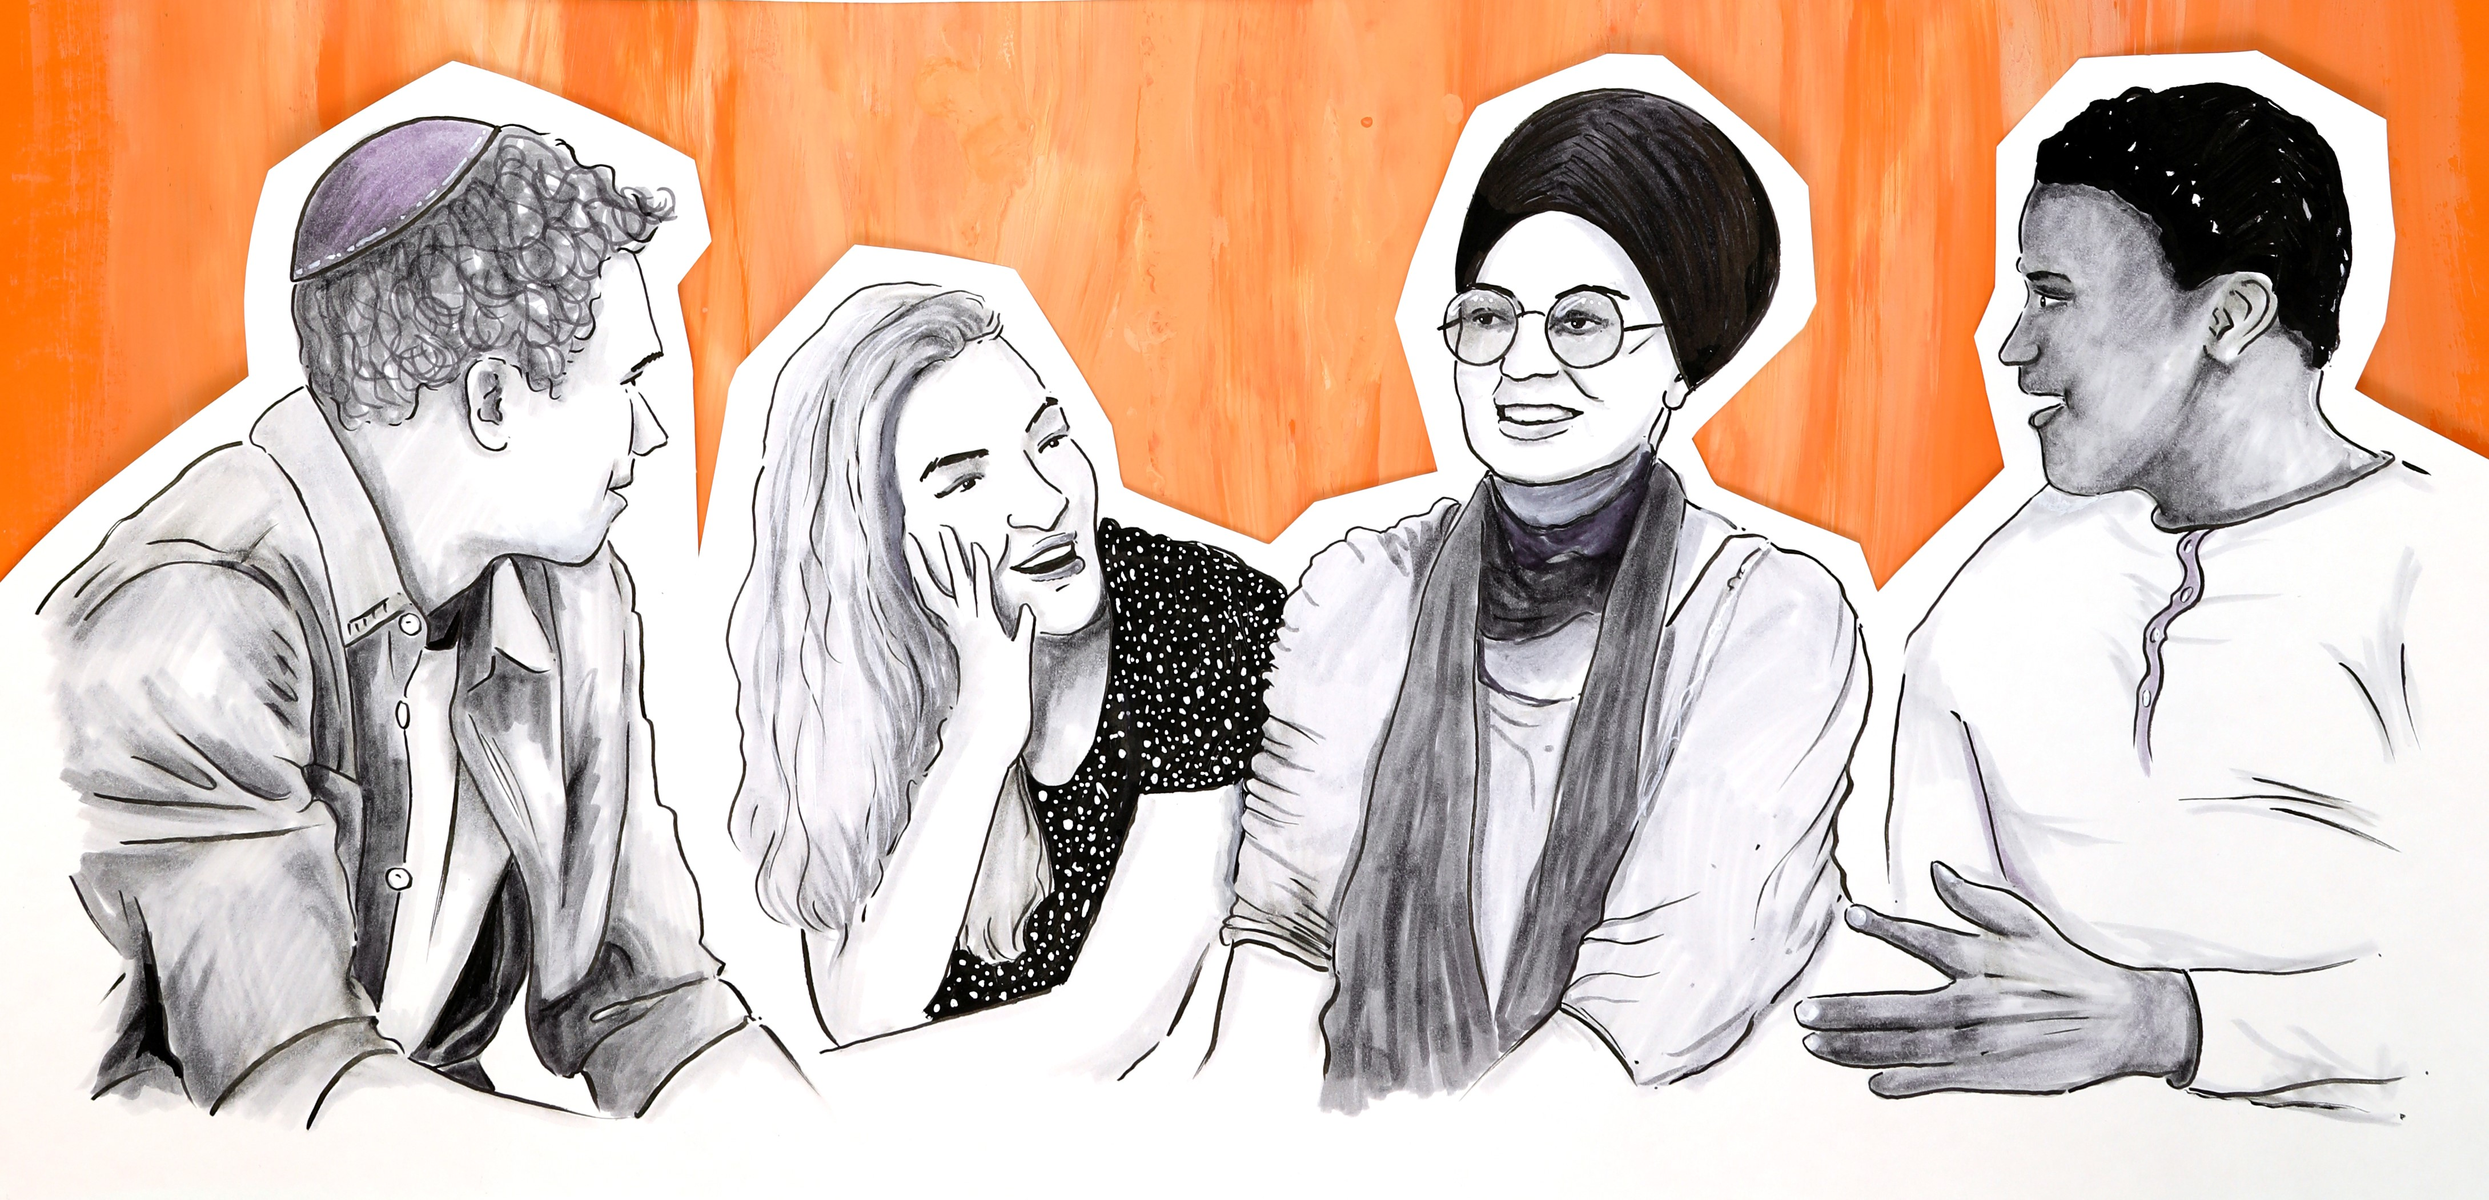
REPLY
R espectful
E motions
P rovide information
L ength
Y ou and I

Slide 4
FEELING – THOUGHTS – ACTIONS, Deep Dive
Individually, on one side of the paper, write a few examples of when you were in a situation that made you feel uncomfortable / awkward.
Think of 3 words to describe how they felt during or after these times and write these on the paper
Turn the paper over and write examples where you felt included, heard, & understood.
Add the feelings that you felt during these examples.

