Slide 1
Respect

Slide 2
Recap of last lesson…
In the last lesson:
we created a safe space agreement
we discussed why it is important to do this, so we all feel comfortable to share our experiences and views
PLAY SAFE SPACE FILM
https://youtu.be/6rBI7UP9-hc

Slide 3
Our Class Agreement
R
A
D
I
O
Insert your Safe Space agreement from lesson 1

Slide 4
Learning Objectives
1. To explore the principle of Respect
2. To understand why it’s important we respect each other
3. To learn about respectful behaviors and disrespectful behaviors

Slide 5
What does respect mean?

Slide 6
Write your answers on post it notes

Slide 7
What does respect mean?
Think, Pair, Share

Slide 8
Respect means: * Being kind to others * Being honest * Telling the truth – being honest * Helping your friends * Not speaking over others * Saying thank you and please

Slide 9
Activity 1 –photos

Slide 10
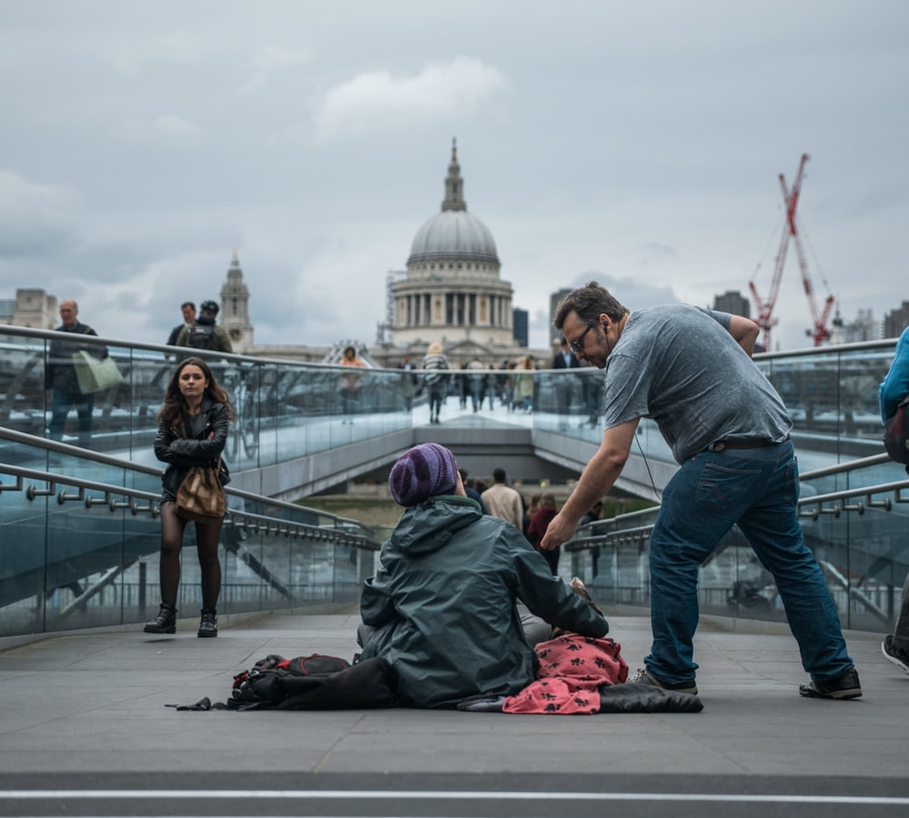
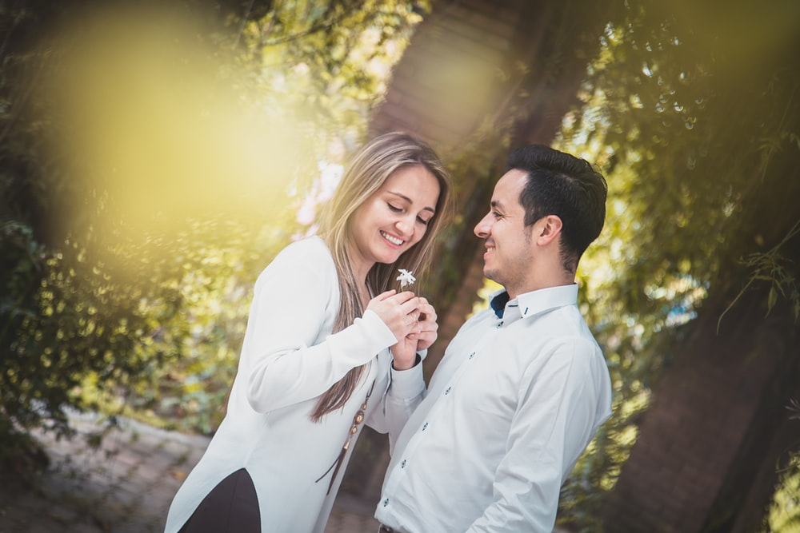
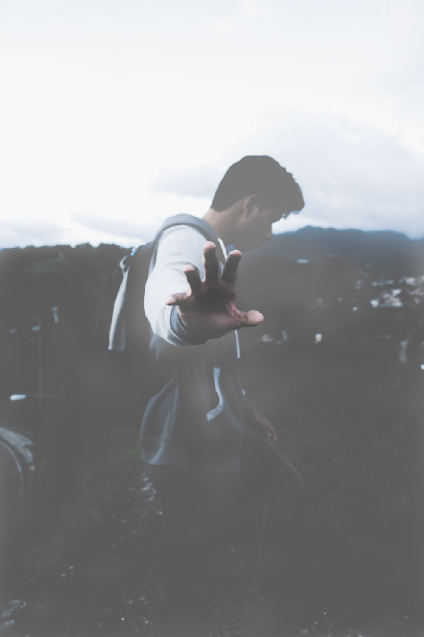
Look at the images and tell us what you see – which of these are respectful and which ones are not? Explain why.

Slide 11
Activity 1 – number photos
1. Why is it respectful/disrespectful? 2. How did this scenario make you feel? 3. How could you change that scenario to be respectful? 4. How does it make you feel when you are not respected?
Think, Pair, Share
Questions

Slide 12
Appreciating Difference

Slide 13
Being ‘different’ to someone else shouldn’t be a bad thing. Difference is something to be celebrated. By appreciating difference and celebrating our identities we are showing respect for each other. It is hard to show respect for others if we don’t understand them. By giving time to understand others, we are showing respect for them.

Slide 14
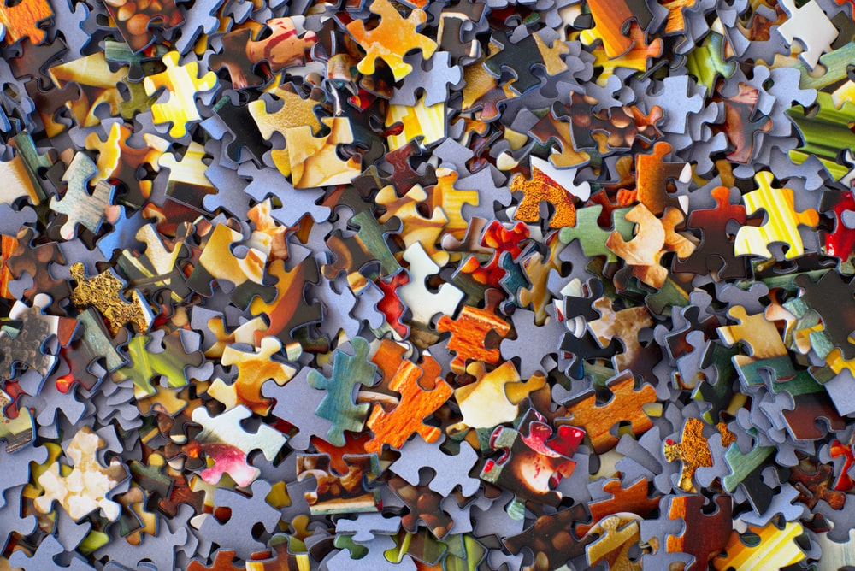
Class Jigsaw

Slide 15
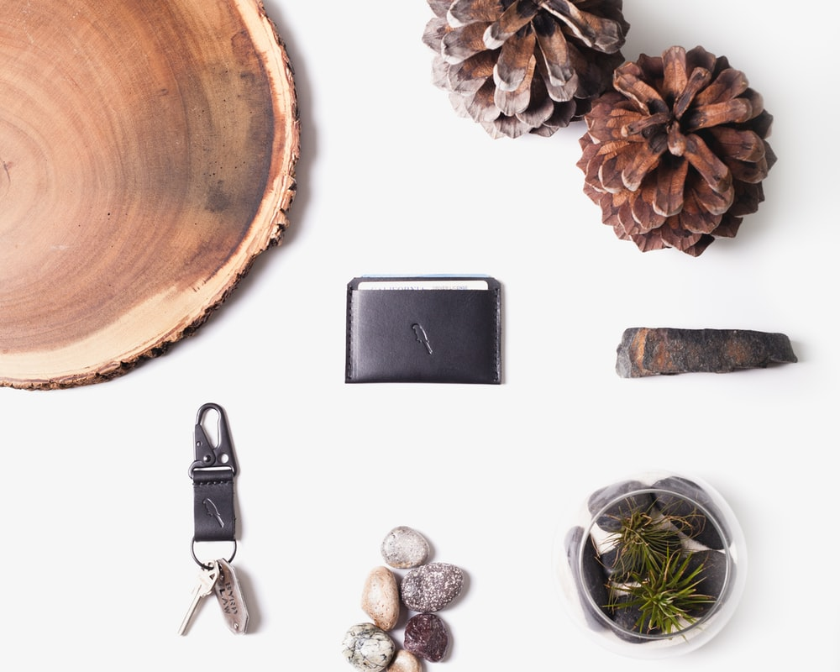
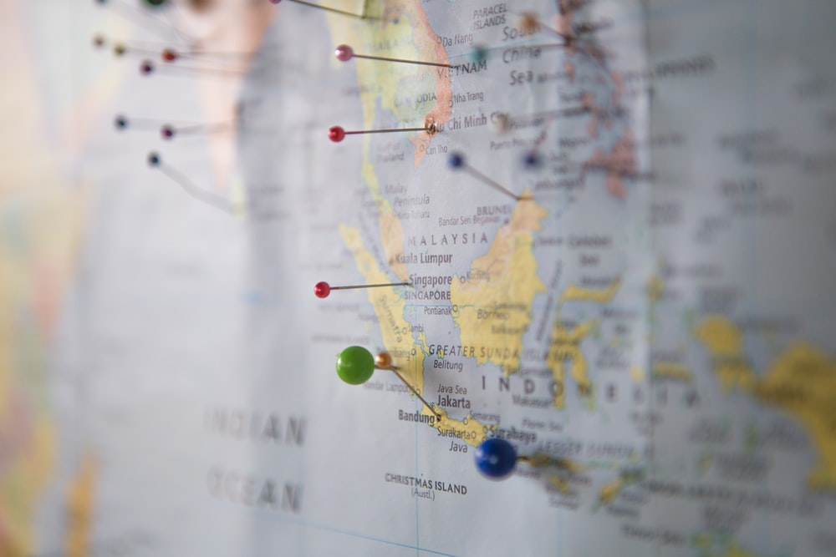
Write or draw on your puzzle piece: Your interests (hobbies, things you like doing on your free time) A special object Something you like about yourself Special place to you

Slide 16
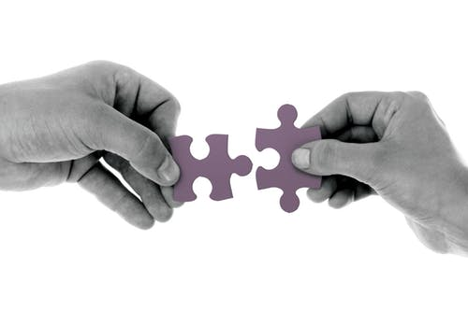
Piecing it together
* We can see that we all like the puzzle pieces fit together, as we can see we all have our own personal interests and things that are important to us but many other things in common
* If we understand each other more it means we are better equipped to show respect towards one another.
* Part of Respect itself is taking the time to understand each other by having meaningful conversations.
* In a multicultural world, we need to learn to respect each other so we can fit together in society. Just like the puzzle.

Slide 17
1.Did you find it easy/difficult to think about what to include on your puzzle? 2. Did you learn anything new about your classmates? 3. Did you find any differences/similarities?

Slide 18
Share with each other: 1. One thing you learnt today 2. One thing you will try to do everyday to show respect to your friends.

Slide 19
We will be exploring how one of the ways we can be respectful to each other is through Active Listening.
The next lesson is
The Letter A

