Slide 1
Dialogue not Debate

Slide 2
Learning Objectives
To understand what a dialogue is
2. To practice having meaningful conversations contribute

Slide 3
What makes you feel comfortable to share things about yourself with others?

Slide 4
Our Class Agreement
R
A
D
I
O
Insert your Safe Space agreement from lesson 1

Slide 5
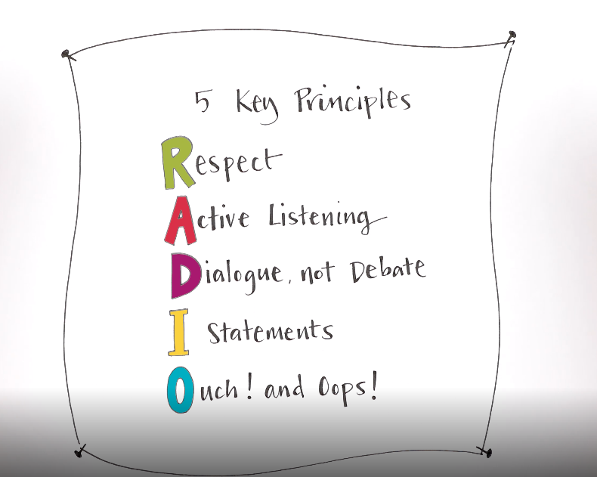
Tune in to RADIO Safe Space!

Slide 6
Safe Space
Principles to create a space that is comfortable ‘Safe’ to bring people together to get to know each other.
PLAY SAFE SPACE FILM
https://youtu.be/6rBI7UP9-hc

Slide 7
Were there any principles you really liked?

Slide 8
What does Dialogue mean? What does Debate mean?

Slide 9
Dialogue vs Debate?
Dialogue
Debate

Slide 10
Dialogue is: ✔ Dialogue is a conversation ✔ Dialogue is body language ✔ Dialogue is listening, being polite and kind, engaging in conversation ✘ not shouting and screaming at each other ✘ putting your point across without caring for the opinion of others

Slide 11
Show Dialogue not Debate clip from Safe Space video
PLAY SAFE SPACE FILM​
https://youtu.be/6rBI7UP9-hc

Slide 12
Why is it important to have conversations with people that are different to us?

Slide 13
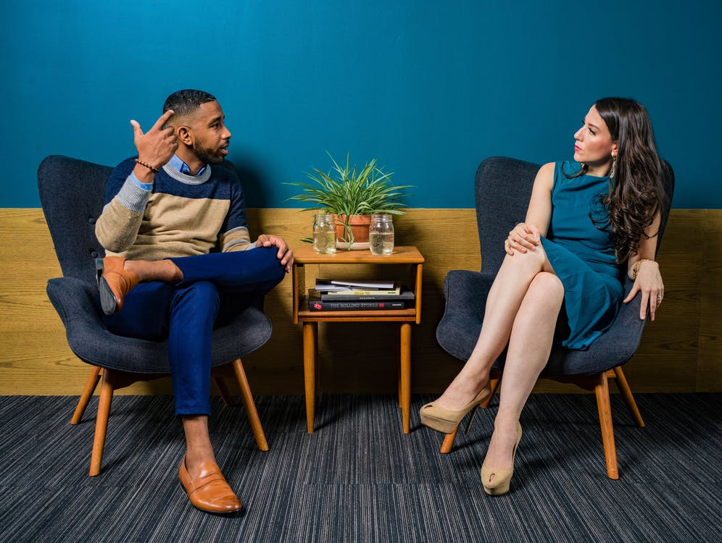
LET’S TALKI

Slide 14
Stand up and walk around the room slowly when you hear ‘FREEZE!’ you stop moving and stand next to the person closest to you A question will appear on the board and you will discuss it with the person closest to you You’ll have 2 minutes to discuss the question Remember: it’s a dialogue not a debate. You should be able to exchange views without getting into an argument
LET’S DIALOGUE!
Instructions

Slide 15
Would you rather have time or money?

Slide 16
Do you think crying is a sign of weakness or strength?

Slide 17
How old would you be if you didn’t know how old you are?

Slide 18
Do you support or appose the death penalty?

Slide 19
What superpower do you wish you had?

Slide 20
1.Who used the active listening skills from the previous lesson? 2.Who found it hard not to debate the question? 3.Who found out similarities/differences about someone else?
Reflection Questions

Slide 21
Dialogue Anagrams

Slide 22
Do to others what you’d like to be done to you = Respect Important and meaningful conversations Actively Listening to Others Getting to know others Understanding Empathising/Equality

Slide 23
Share with each other: One thing you’ll do to ensure we always have respectful, meaningful conversations?

Slide 24
The next lesson is​ ​ The Letter I
Next lesson we will be moving on to look at ‘The letter I’, and exploring how we use ‘I statements’ to talk from our own perspectives in dialogues.

