Slide 1
Role of Religion Skill: Critical thinking

Slide 2
Introduction & Learning Objectives
Skill: Spotting our own biases and thinking critically about the media or information we consume; holding assumptions lightly and emphasising nuance.
To examine our own information consumption and identify our own personal biases
To understand how critical thinking can help to spot bias and agenda in narratives
To practice seeking wide ranges of information and holding our own assumptions lightly
Revisit your RADIO Safe Space agreement or watch the Safe Space film
Safe Space film click PLAY

Slide 3
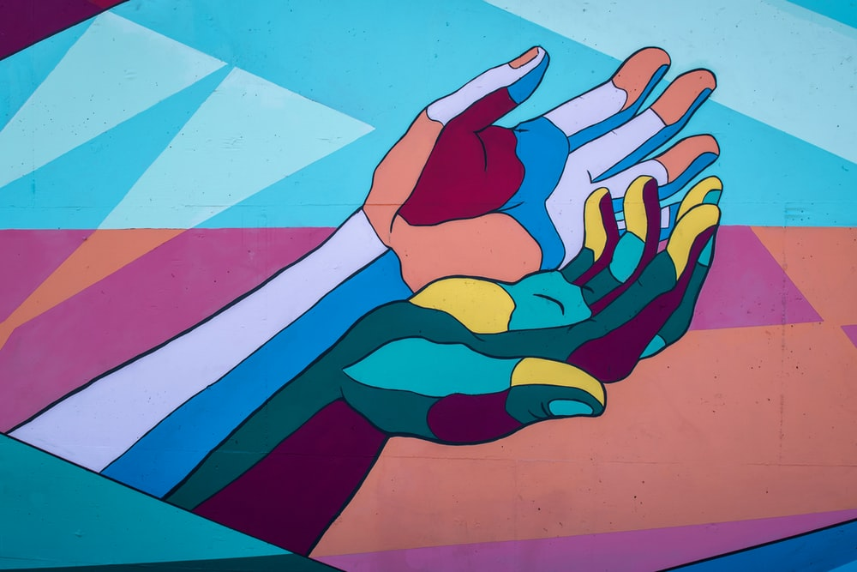
How do we go about informing ourselves; what are our sources and how do we navigate them?
‘Does religion
unite or divide society?
YES
IT DEPENDS
NO

Slide 4
Where do your opinions and information come from?

Slide 5
Controversial Issues Film
PLAY
Click PLAY above or go to
https://www.youtube.com/watch?v=5MsIZhIYiJg
What does bias mean?
Where do we see bias in our sources of information?
Where we see bias in ourselves?
How does this affect dialogue around controversial issue?

Slide 6
Part 1
Views on Religion worksheet
Thinking critically about sources
What do you think of this opinion?
What is this person’s worldview? Do we know?
What part of this is factual? Which parts can we fact-check?
Is there any bias here? Why / where / how?
Is any of their language harmful?
How does this match what you usually hear?

Slide 7
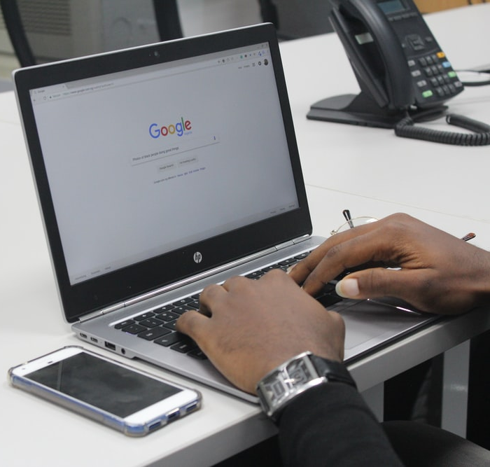
Part 2
Thinking critically about ourselves
My Biases worksheet
What sources of information are in my comfort zone / do I instinctively get pulled into?
What sources of information make me feel uncomfortable / make me instinctively recoil?
What kind of language is appealing / unappealing to me?
What kind of imagery is appealing / unappealing to me?
What kind of people do I like to agree with / disagree with?
How often do I look for information that supports my opinions?
How often do I look for information that contradicts my opinions?

Slide 8
Questions/reflections
What are some of the top tips for engaging critically around an issue?

Slide 9
Top tips!
How do we go about informing ourselves; what are our sources and how do we navigate them?
Acknowledge which sources you have and haven’t consulted / are and aren’t exposed to
Try to establish the source’s bias and look out for any red flags: harmful / de-humanising language, etc.
Separate opinion from fact: fact-check the latter
Reflect on your own response (how do you feel? what do you think of it?) to that information and what bias of your own that response reflects
Seek opposing, alternative or a broad range of views on an issue in order to compare and contrast, getting a fuller picture

Slide 10
Think about one issue you engage with this week, that’s relatively controversial . Answer the questions in writing about it.
Homework

Slide 11
Homework questions:
1 What controversial issue did you engage with?
2 What did the conversations you had or the articles / opinions you read tell you?
3 Seek two alternative or opposing narratives on the issue: how did you decide what these should be, and where to find them? (Hint: what can you say about your existing info?)
4 What did you learn from comparing and contrasting them to your original sources?

Slide 12
Next Lesson:
We’ll be looking at the fact that controversial issues evoke strong emotions in us and other people, and how this can act as a barrier to engagement.

