Slide 1
Do environmentalists do more harm than good? Skill: Respecting and accepting difference

Slide 2
Introduction & Learning Objectives
Skill: Acceptance, including difference. To truly internalise the mantra ‘It’s ok to disagree’ and move towards being open to learning something from people we can’t necessarily agree with
To be able to understand how our own identities, backgrounds and experiences shape our views
To practice the skill of accepting and moving past difference
To explore learning something new from those we can’t agree with

Slide 3
Recap skills
Confidence
Critical thinking
Emotional intelligence
Revisit your RADIO Safe Space agreement or watch the Safe Space film
Safe Space film click PLAY

Slide 4
‘Do environmentalists do more harm than good?’

Slide 5
What’s happening here?
PLAY Click PLAY above or go to
https://www.youtube.com/watch?v=5MsIZhIYiJg
Have you ever felt like you’ve fundamentally disagreed with someone?
What are the factors in these characters’ disagreements?
How do they feel and what path does the conversation look like it will take?
What do the blue and yellow-themed images in their thought bubbles symbolise? How do these affect what they say?
What might those scenes be in our case?

Slide 6
Environmentalism and Us
Do environmentalists do more harm than good?
Complete the following sentences:
I believe...
My relevant values to this belief are...
The life experience that has given rise to this belief is...
The ways in which I practice this belief are...

Slide 7
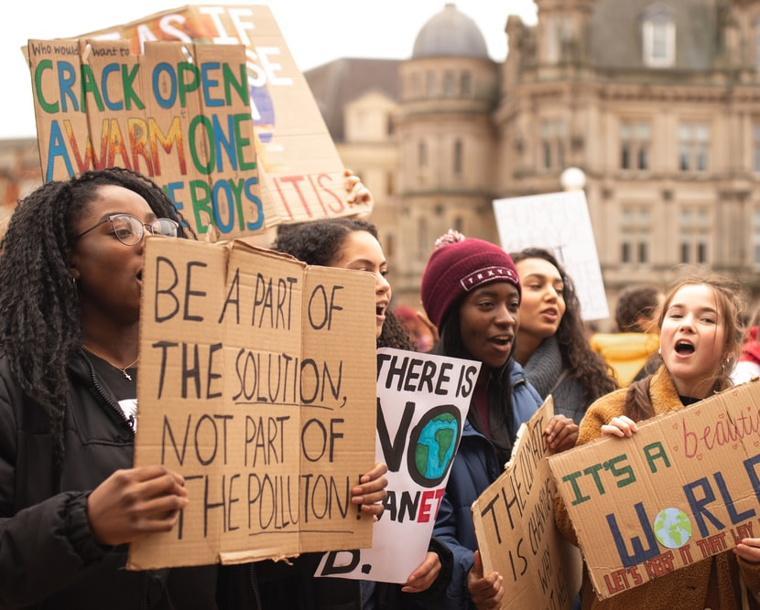
Testimonies
X believes...
The life experience that has given rise to this belief is…

Slide 8
What’s happening here?
PLAY
Click PLAY above or go to
https://www.youtube.com/watch?v=5MsIZhIYiJg
They’ve chosen to listen and learn more about the perspective of the other person. Their language shows appreciation for that person’s viewpoint and an open mind to learn something from them
Move to reveal

Slide 9
Pair work
Accepting difference and Appreciating the other person’s perspective
Role play!
each take on the persona of one of the two characters
Imagine they have met and have gotten onto the subject of whether environmentalists do more harm than good.
Try and include:
A bit of context about where they have met
Each person introducing themselves and giving their opinions on the matter
Both people asking the other about the life experiences that have shaped their views
Both people finding one thing they can learn from the other, or one strength in the other person’s argument• Both people reflecting on one weakness in their own argument, in light of the discussion

Slide 10
Reflection
• One thing that I thought about differently today
• One behaviour I will change going forward
• One aspect of myself / someone else I have understood better

Slide 11
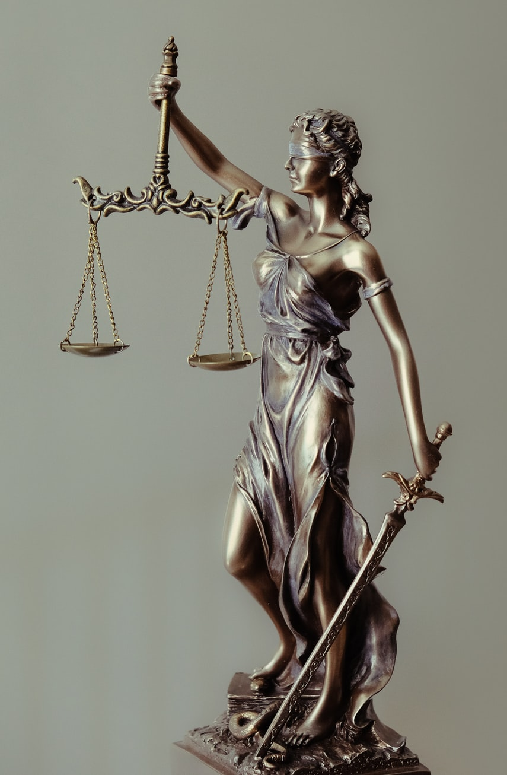
Top tips
Understand which aspect of your identity or life experience is shaping your view on this particular issue
Try to understand through research or dialogue what experience is shaping the viewpoint of the person or group that you disagree with• Accept that difference is a fundamental fact of life
Recognise when a conversation is no longer making room for understanding, or when one party is trying to ‘convert’ the other
Steer your mindset and the conversation towards what you may be able to learn or share in any case, without needing to ‘agree’ or ‘win’
Understand that you can admire or respect something in someone else’s experience without having to negate or erase your own

Slide 12
Write a piece engaging with the opinion of a public figure or group whom you strongly disagree with
Homework

Slide 13
Homework Questions
Write 500 words on the following:
1 What is the issue and what do we each believe?
2 How has my identity or life experience shaped my view on this? How has theirs?
3 Are there any truly fundamental differences between our viewpoints?
4 Is there anything I can admire about or learn from their perspective?
5 Does engaging with their argument point to any weakness in my own argument?

Slide 14
Next Lesson:
Crime and rehabilitation
What happens when we oversimplify issues and our responses to them

