Slide 1
Crime and Rehabilitation Skill: Being open-minded and flexible

Slide 2
Introduction & Learning Objectives
Skill: Flexibility – how can we resist the idea of ‘camps’ surrounding a certain issue, and open up space for fluidity and complexity?
To identify the dangers of siding with one ‘camp’ around a controversial issue
To reflect on the importance of keeping an open-mind and actively listening

Slide 3
Recap
Ongoing barriers to and top tips for approaching controversial issues:
Being unsure of oneself: being reflective and prepared in order to increase self-confidence;
Facing misinformation: developing skills for critical thinking so as to consume information responsibly and constructively;
Strong emotional reactions: developing emotional literacy so as to avoid derailment of discussion
Sometimes it’s impossible to agree, accepting the fact that we all come from different backgrounds and taking the opportunity to learn.

Slide 4
How to resist getting stuck in a ‘camp’ over a particular issue
PLAY
Click PLAY above or go to
https://www.youtube.com/watch?v=5MsIZhIYiJg

Slide 5
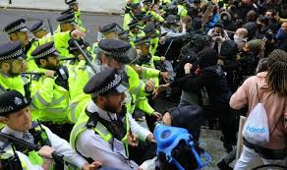
topics which have been polarising in recent times

Slide 6
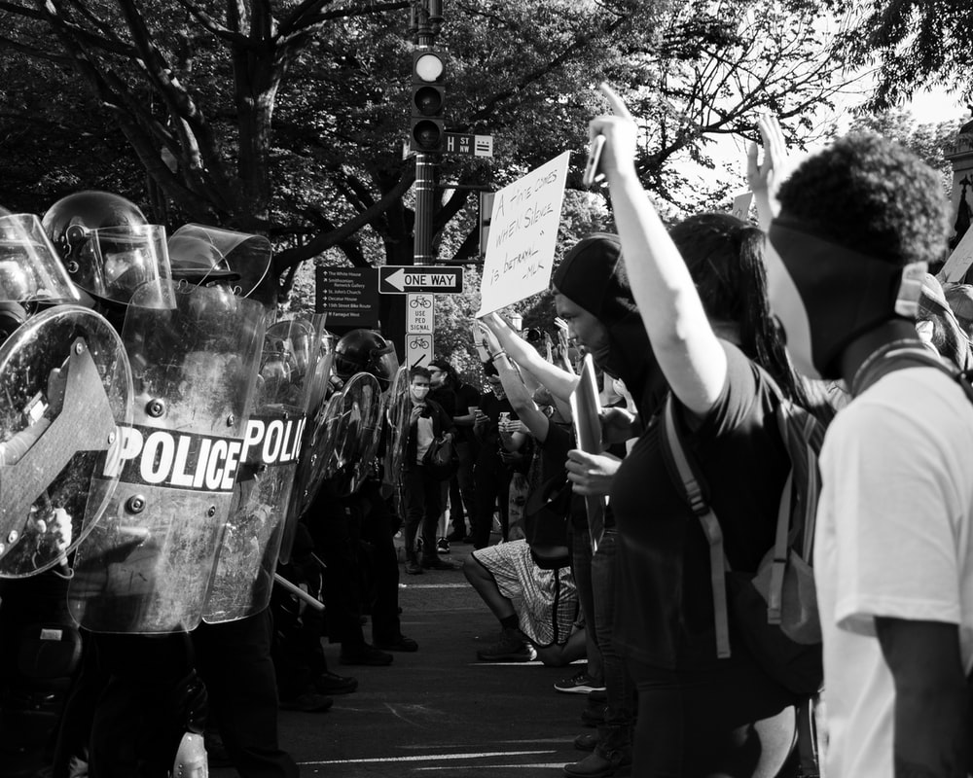
How do we become polarised?
Do we sometimes feel we’re on a ‘side’ of an issue we don’t know much about? How does this happen / who can influence this?
How does it feel to be on one ‘side’ of an issue?
How do we speak about the other ‘side’?
How easy is it to agree with or promote the ideas of the other side?
What is the danger in being polarised in this way?

Slide 7
Key ideas

Slide 8
Revisit your RADIO Safe Space agreement or watch the Safe Space film ​
Safe Space film click PLAY

Slide 9
Should the government rehabilitate convicted persons with life sentences?

Slide 10
Which crimes get life sentences?
Murder – mandatory life sentence (England and Wales)
Rape – possible life sentence
Armed robbery – possible life sentence
A life sentence lasts for the rest of a person’s life – if they’re released from prison and commit another crime they can be sent back to prison at any time.
Source: https://www.gov.uk/types-of-prison-sentence/life-sentences

Slide 11
Yes
No
Should the government rehabilitate convicted persons with life sentences?

Slide 12
Reflection
How easy is it to agree with or promote the ideas of the other ‘side’?

Slide 13
Reflection
What is the danger in being polarised in this way?

Slide 14
Reflection
How can we better approach a controversial issue when we find ourselves on a particular ‘side’?

Slide 15
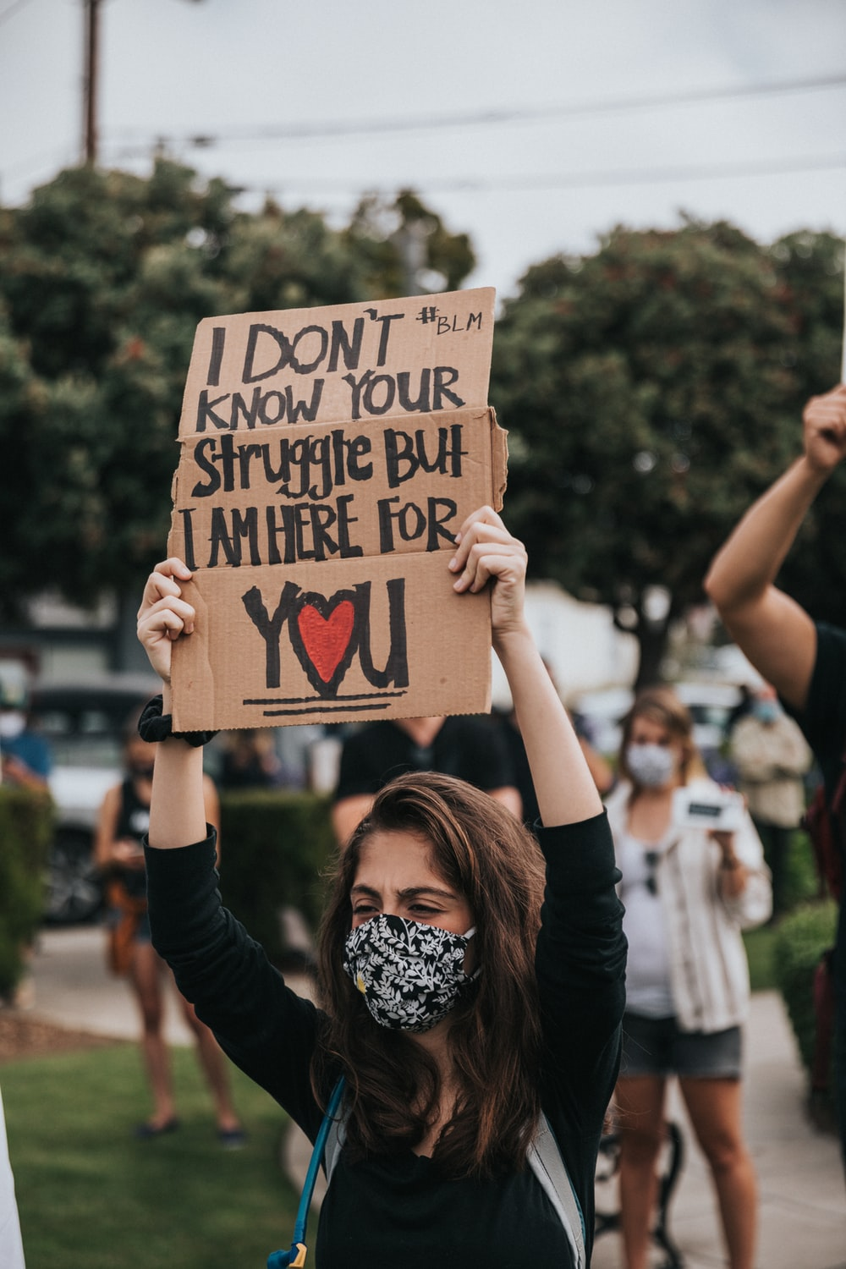
Top tips
Always be aware of how you are forming and voicing your opinion around an issue; are you following the group you find yourself in?
Do you see another ’side’ of the issue, and if so have you tried to find common ground?
Take time to think about arguments and perspectives ‘opposing’ yours with an open mind
Try to be remain critical about the things you are hearing about an issue; avoid divisive rhetoric like ‘them’ and ‘us’ or statements which make assumptions about what people who don’t agree with you believe, or who they are

Slide 16
Choose a controversial topic you are uncomfortable with and write a personal strategy for how to approach conversation around it. Describe where the conversation takes place and with who.
Homework

Slide 17
Use the skills learnt to help...
1 First establishing who you are and what you will bring to the discussion
2 For the information you are lacking, how to sensibly and safely research it further
3 What emotions you anticipate to be invoked in yourself and others, and how to respond
4 What you fear will be the sticking points, red lines or dead ends, and what you can still gain
5 How to resist falling into one ‘camp’ of the issue and reach your own resolution

