Slide 1
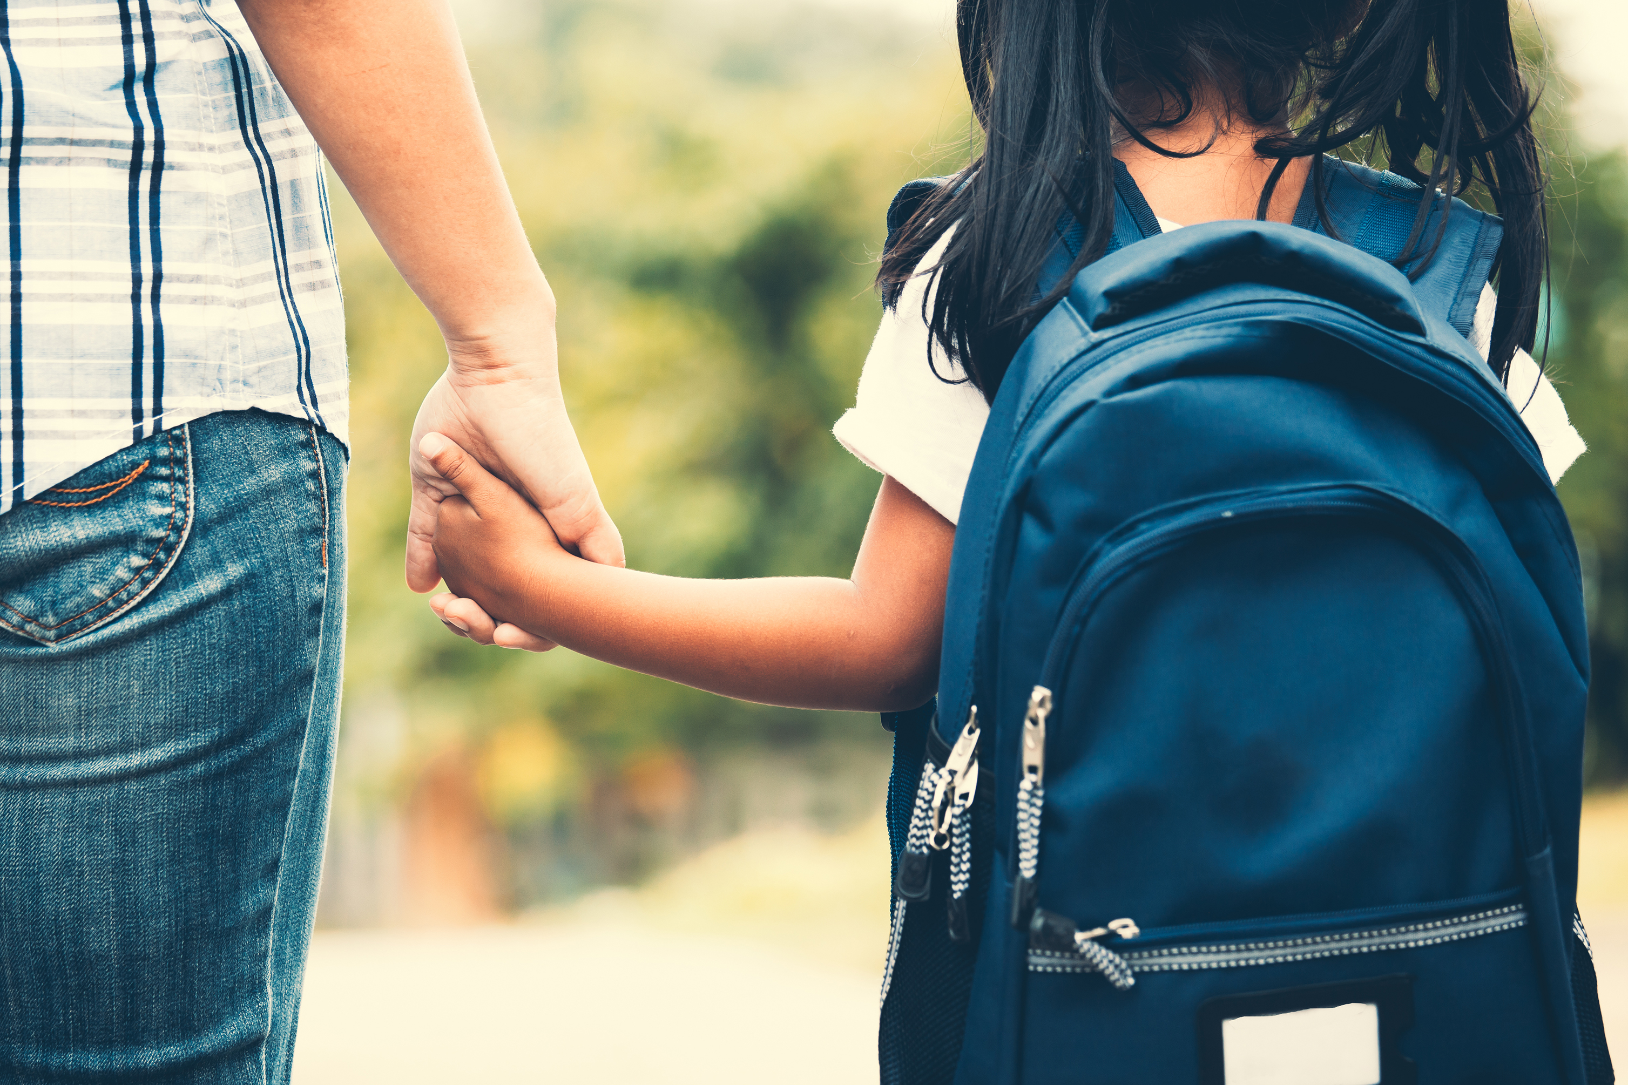
Visible and Invisible Identity

Slide 2
Today we are going to explore parts of our Identity that might be visible (what we can see) and what might be invisible (can’t been seen with our eyes).

Slide 3
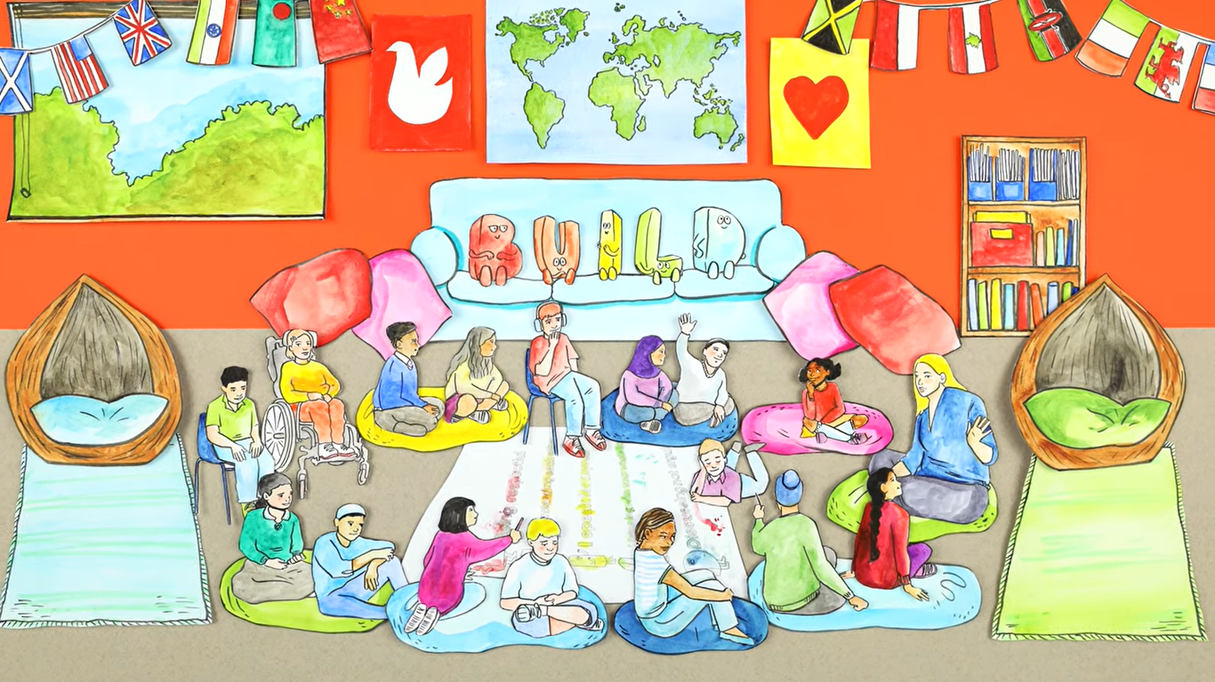
Safe Space film
Today we will be talking more about who we are and what makes you YOU. Therefore, it is important that the classroom is a happy and friendly space where we can all share our views, thoughts and feelings.
Safe space film

Slide 4
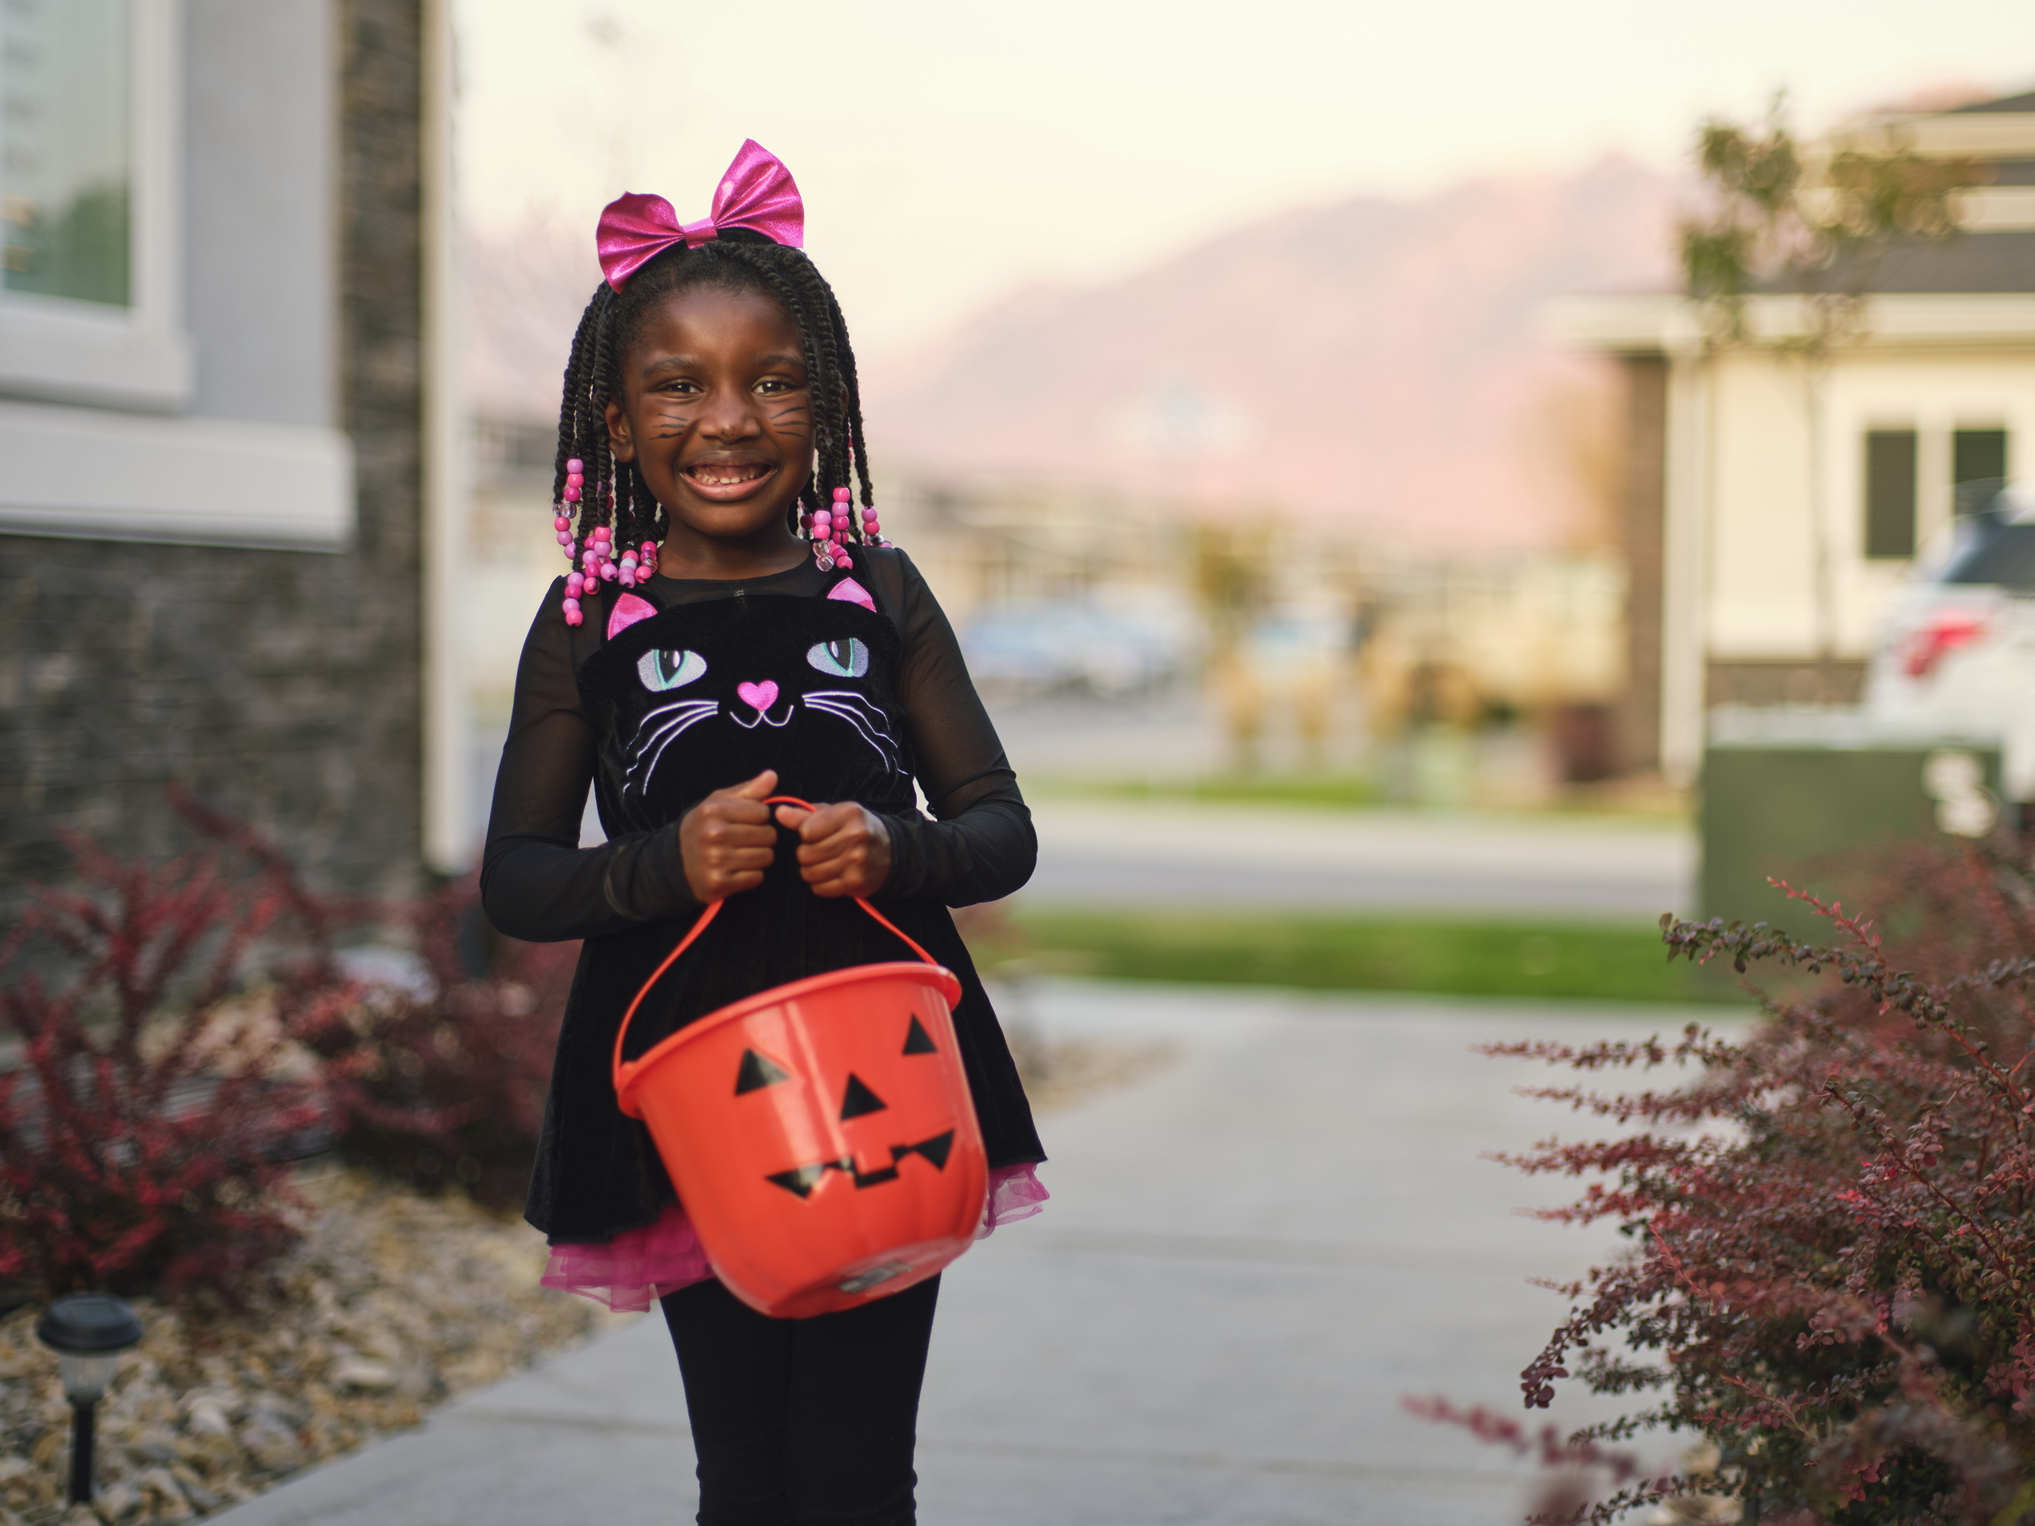
Activity 1: Activity Factor!
I have black hair
My favourite colour is pink
I love Halloween
I feel shy when I meet new people
I don’t like apples
I am good at singing • I go to church every Sunday

Slide 5
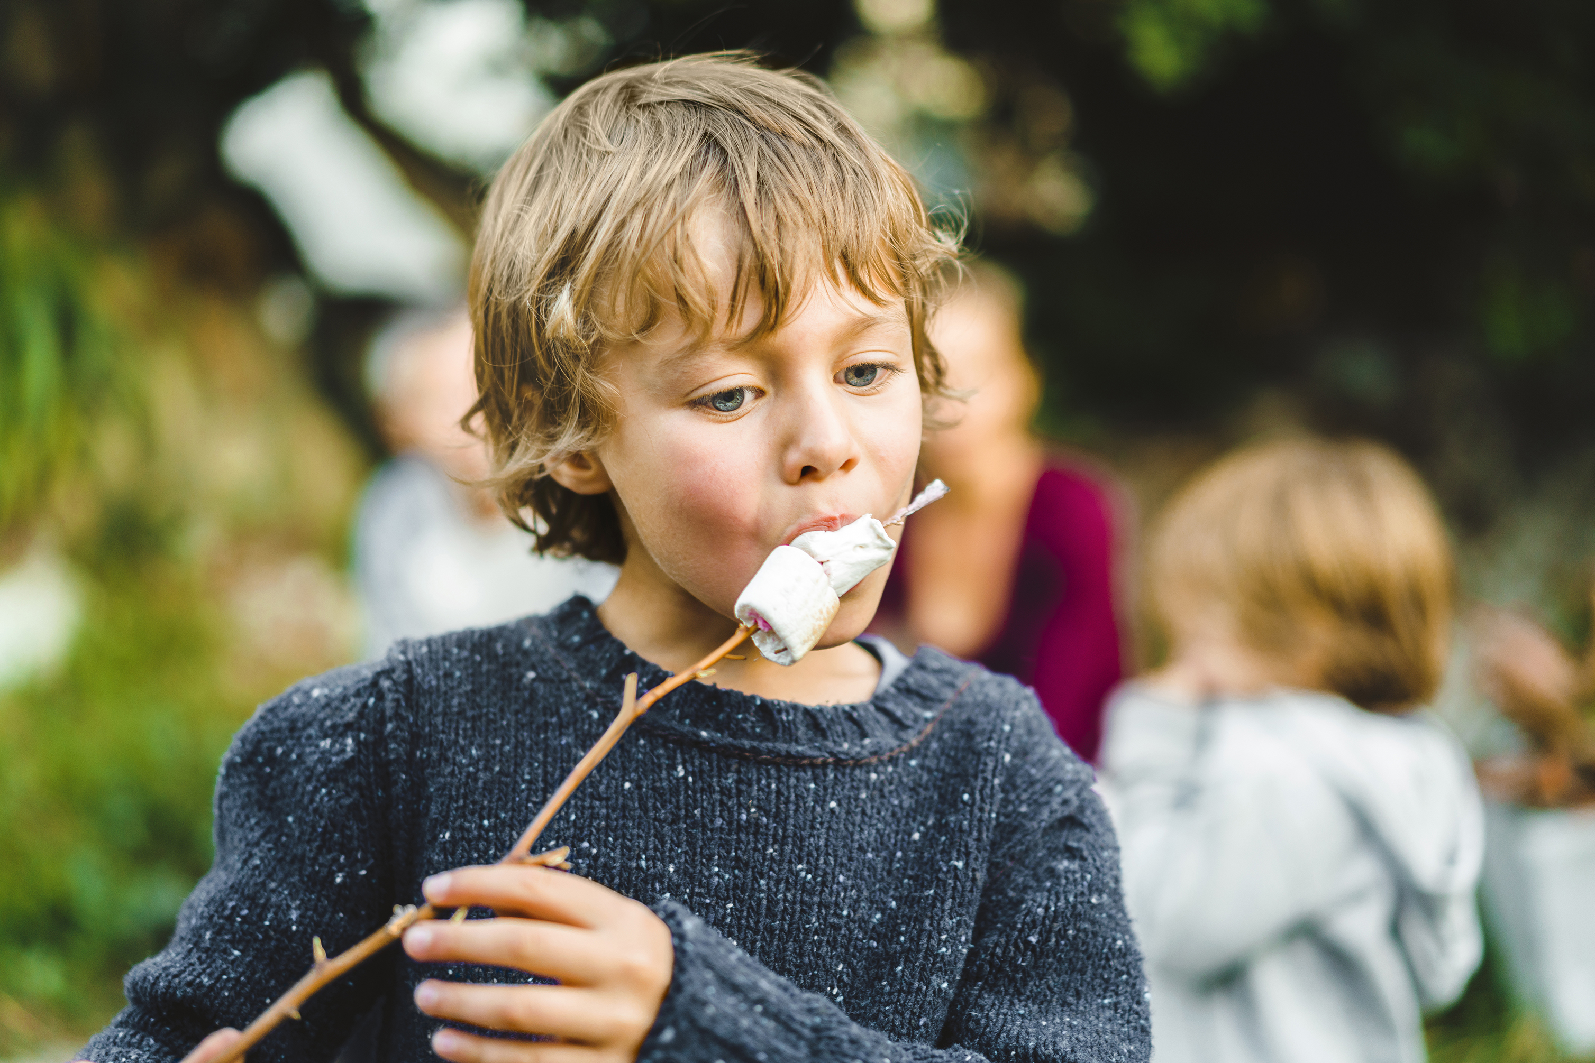
Activity 1: Activity Factor!
I have red/blond hair
I am good at art
My favourite colour is blue
I have a brother
I hate carrots
I love being outside
I speak another

Slide 6
Thoughts...
There are some parts of our identity we can see, and some of them we can’t, and we would need to ask someone or spend time with them to know that about them.

Slide 7
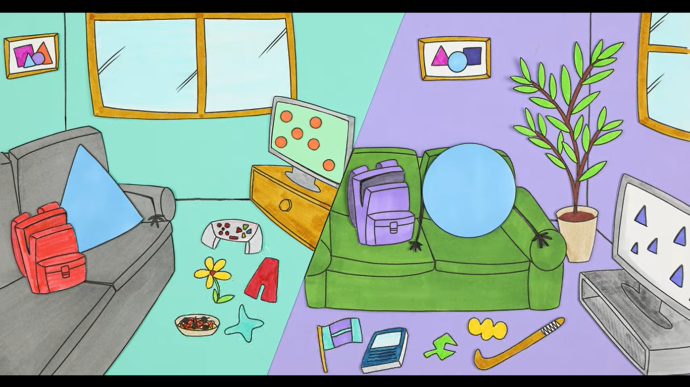
Spot the difference!
Watch the identity film and pause after 50 seconds!
Play film
Why do you think a picture of a backpack would be a good way to think about identity?
Do they have things in common?
Activity 2: Identity film

Slide 9
My backpack!
See me and you’ll learn: outside and in front of the bag Examples: Skin / hair colour, gender, height, clothes I like to wear etc.
Meet me and you’ll learn: inside of the bag
Examples: Hobbies, interests, favourite subjects at school etc.
Spend time with me and you’ll learn: pockets
Examples: Dislikes, any siblings, what I want to be when I grow up, faith, beliefs etc.
Anything that makes up who you are that is not listed: zips (students to draw on)
Examples: Favourite festival, object / possession, pet, shape
Activity 3
My backpack!

Slide 10
My Identity Worksheet
Which places are important to me and my family?
Which people are important to me in my life?
What is my personality like?
What do I look like?
What beliefs and values are important to me?
What do I like doing?
Activity 4:
My activity worksheet

Slide 11
Thoughts…
• How did you find the activity?
• Which bits were most challenging? Why?

Slide 12
Next lesson…
Next lesson we will be writing stories about our name!

